Slide 1
FREQUENCY MODULATION
Dr Vimal Sharma

Slide 2
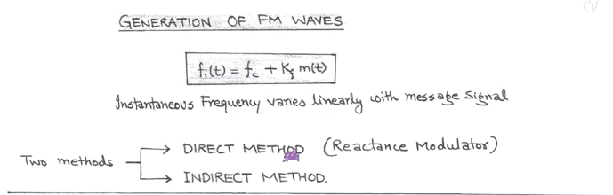

Slide 3
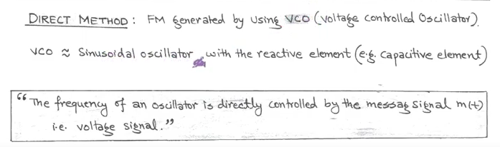

Slide 4
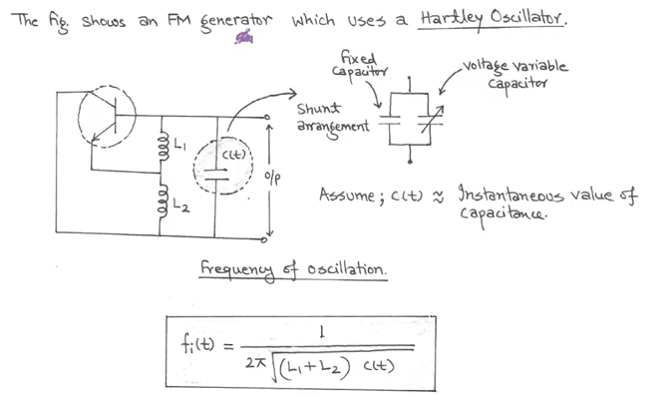

Slide 5
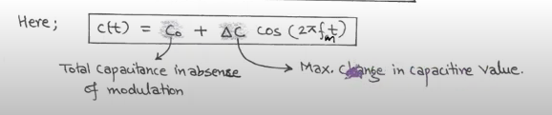

Slide 6
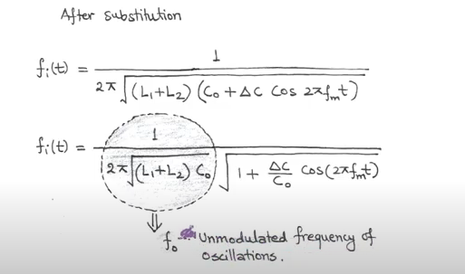

Slide 7
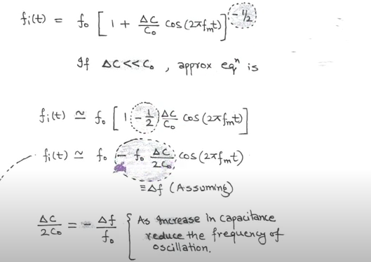

Slide 8
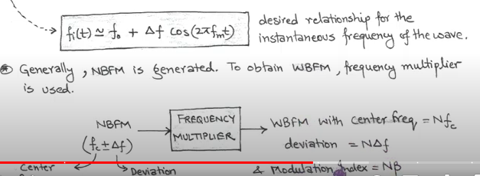

Slide 9
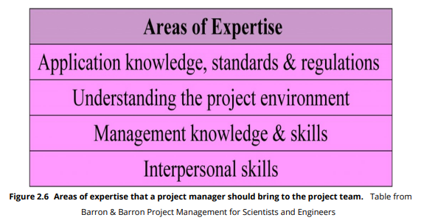

Slide 10
Organization Structure
Functional Organizational Structure
Project Organizational Structure
Organization Structure
Matrix Organizational Structure

Slide 11
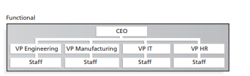
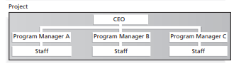
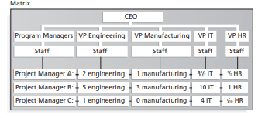

Slide 12
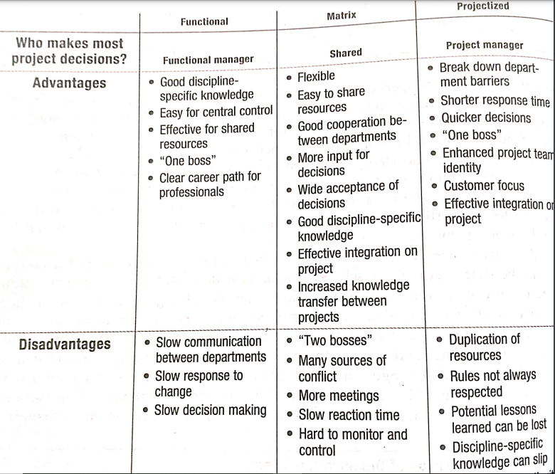

Slide 14
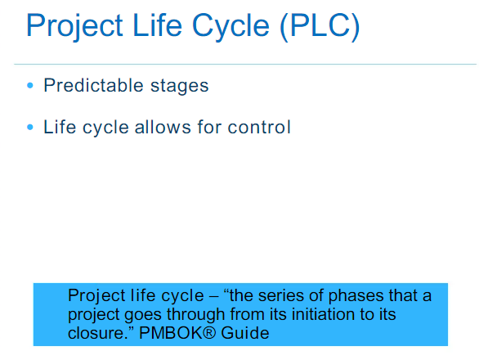

Slide 15
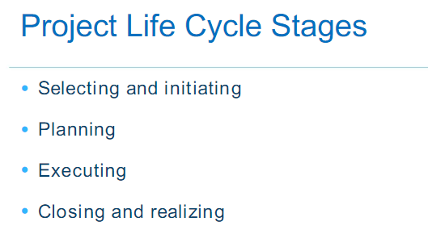

Slide 16
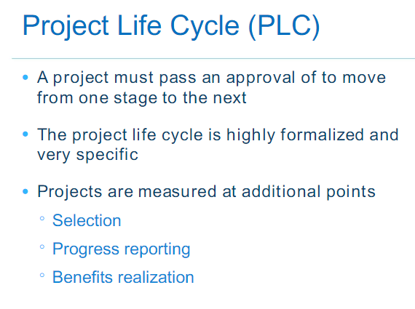

Slide 17
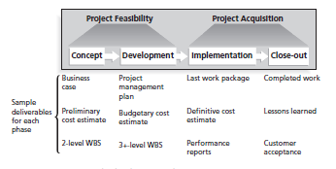

Slide 18
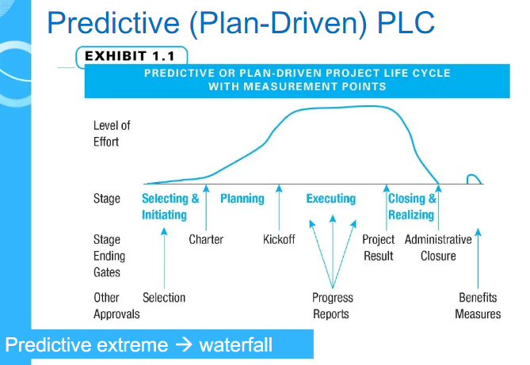

Slide 19
Predective Life Cycle
Linear stages of system analysis,design, construction and support
Waterfall Model
Spiral Life Cycle Model
Based on experience with refinements of waterfall model
Progressive development of operational software
Incremental Build Life Cycle Model
Prototyping Life Cycle Model
Developing s/w prototype to clarify user requirements
Heavy involvement of RAD tools CASE,JRP,JAD
RAD life cycle model

Slide 20
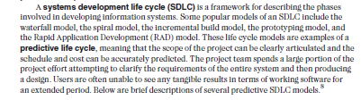

Slide 21
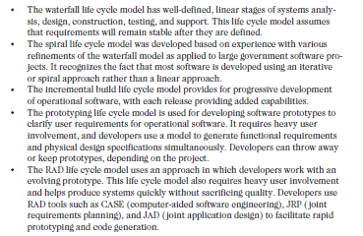

Slide 22
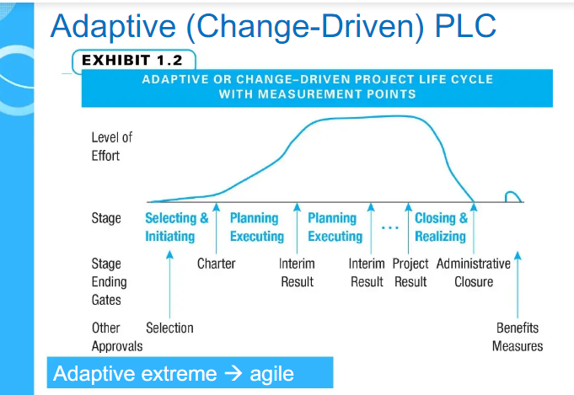

Slide 23
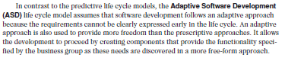

Slide 24
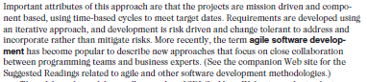

Slide 25
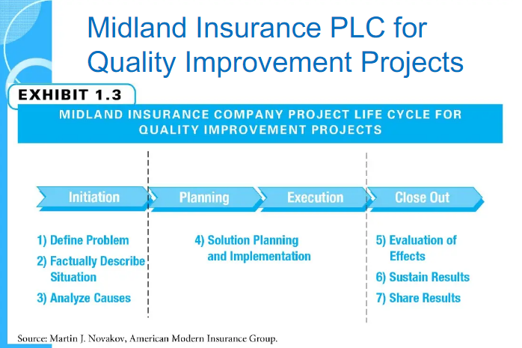

Slide 26
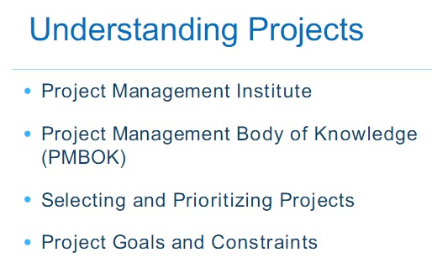

Slide 27
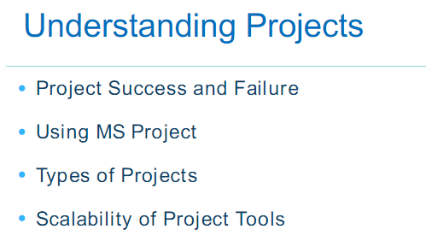

Slide 28
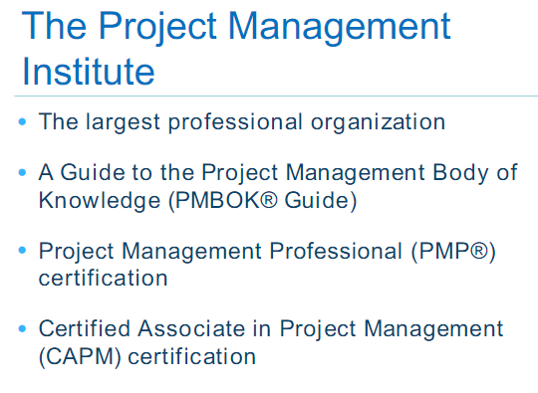

Slide 29
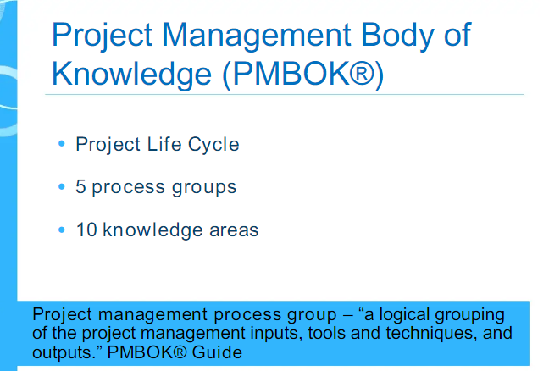

Slide 30
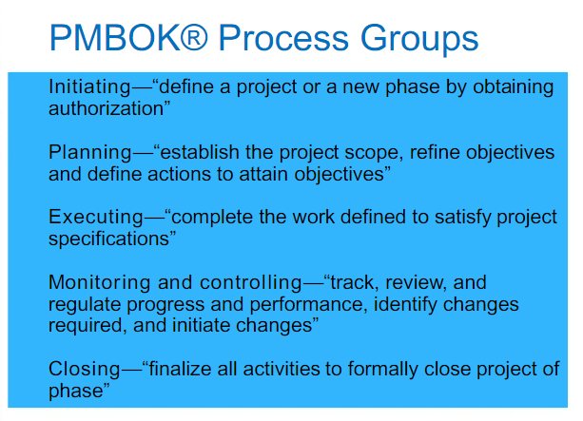

Slide 31
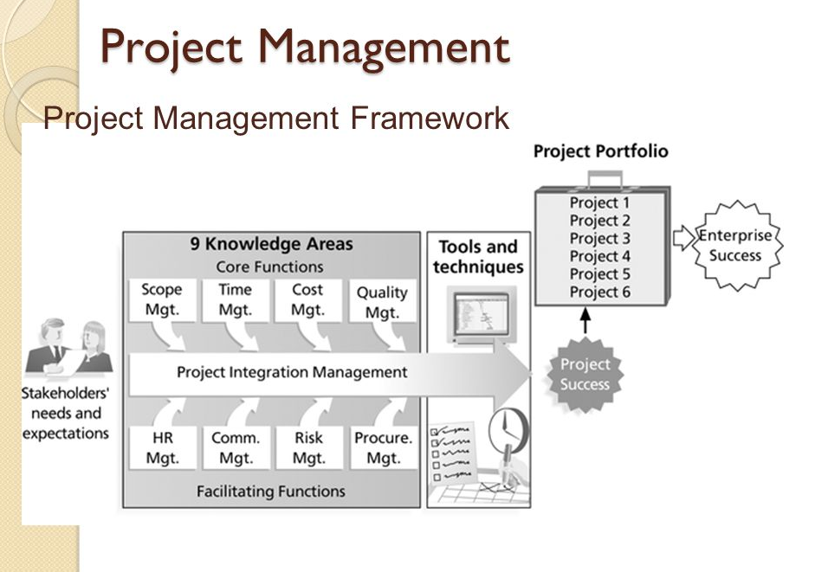

Slide 32
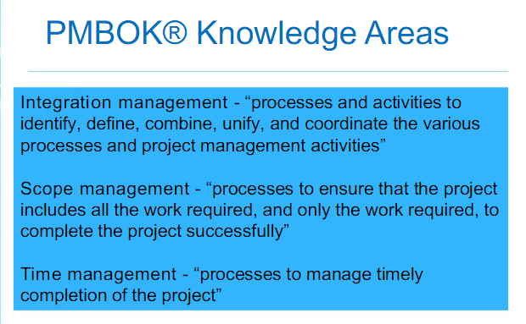

Slide 33
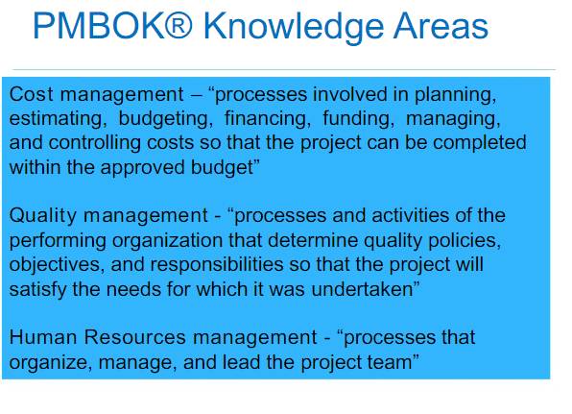

Slide 34
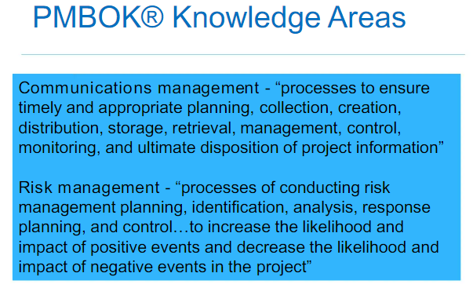

Slide 35
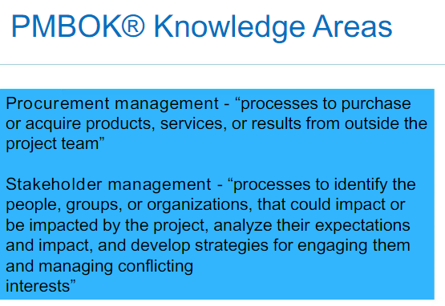

Slide 36
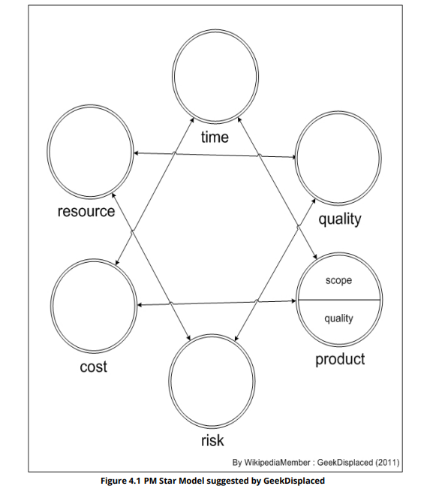

Slide 37
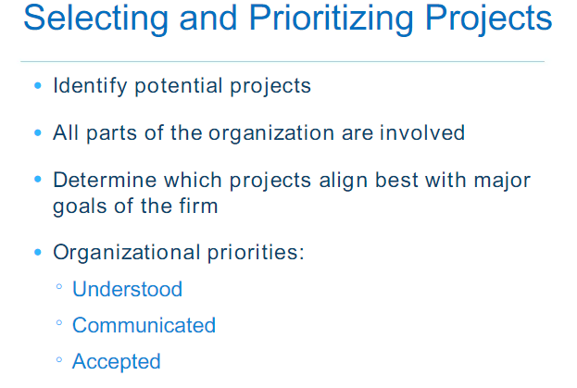

Slide 38
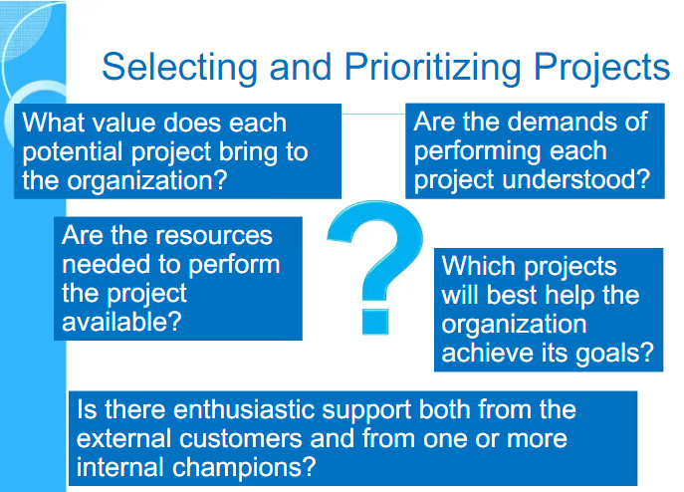

Slide 39
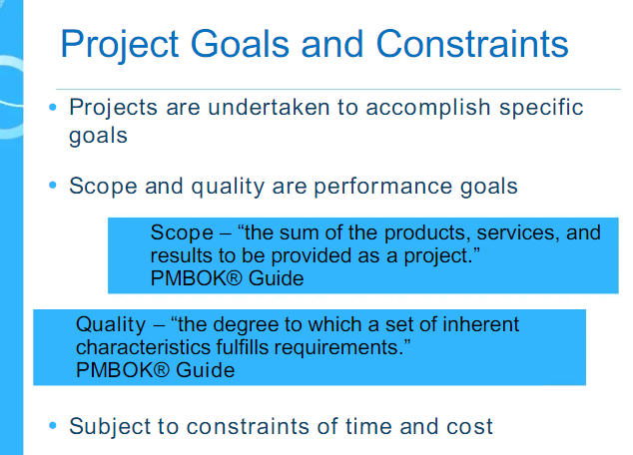

Slide 40
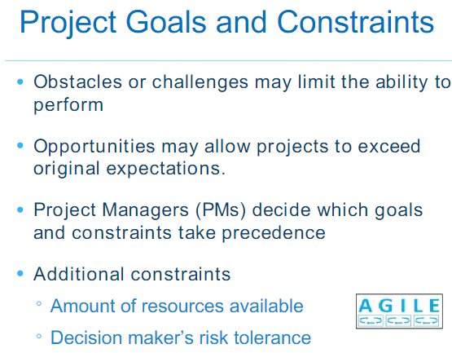

Slide 41
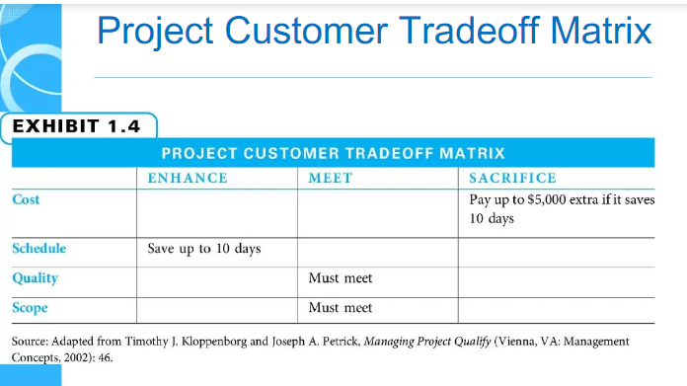

Slide 42
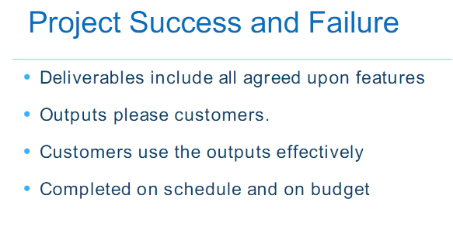

Slide 43
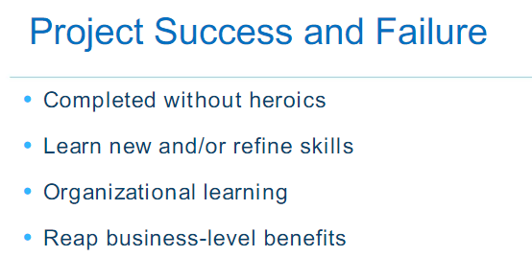

Slide 44
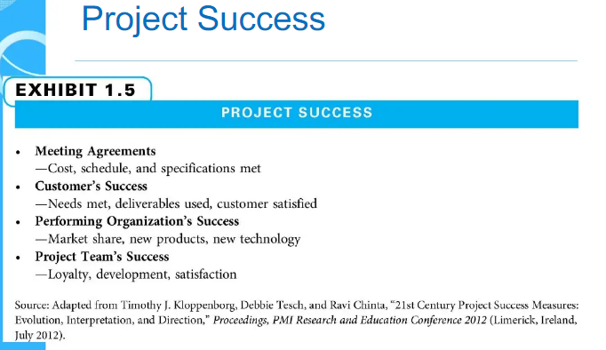

Slide 46
Knowledge Area / Category | Tools and Techniques
Integration management | Protect selection methods, project management methodologies, stakeholder analyses, project characters, project management plans, project management software, change requests, change control boards, project review meetings, lessons-learned
Scope management | Scope statements, work breakdown structures, statements of work, requirements analyze, scope management plans, scope verification techniques, and scope change controls
Time management | Gantt charts, project network diagrams, critical path analysis, crashing, fast tracking, schedule performance measurements

Slide 47
Cost management | Net present value, return on investment, payback analysis, earned value management, project portfolio management, cost estimates, cost management plans, cost baselines
Quality management | Quality metrics, checklists, quality control charts, Pareto diagrams, fishbone diagrams, maturity models, statistical methods
Human resource management | Motivation techniques, empathic listening, responsibility assignment matrices, project organizational charts, resource histograms, team building exercises

Slide 48
Communications management | Communications management plans, kick-off meetings, conflict management, communications media selection, status and progress reports, virtu-al communications, templates, project Web sites
Risk management | Risk management plans, risk registers, probability/ impact matrices, risk rankings
Procurement management | Make-or-buy analyses, contracts, requests for proposals or quotes, source selections, supplier evaluation matrices

Slide 49
More Advantages of Project Management
Bosses, customers, and other stakeholders do not like surprises
Good project management (PM) provides assurance and reduces risk
PM provides the tools and environment to plan, monitor, track, and manage schedules, resources,costs, and quality
PM provides a history or metrics base for future planning as well as good documentation
Project members learn and grow by working in a cross-functional team environment

Slide 50
How Project Management (PM) Relates to Other Disciplines
Much of the knowledge needed to manage projects is unique to PM
Project Managers must also have knowledge and experience in general management
Project managers must focus on meeting specific project objectives

Slide 53
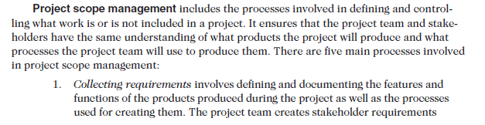

Slide 54
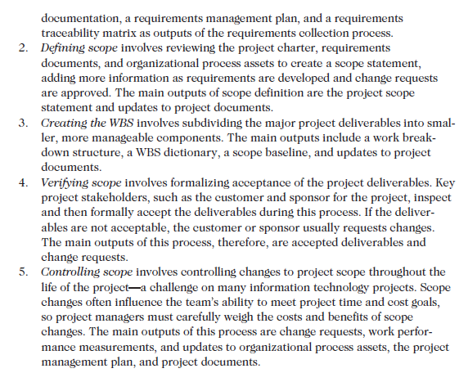

Slide 55
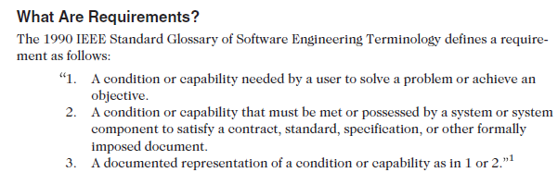

Slide 56
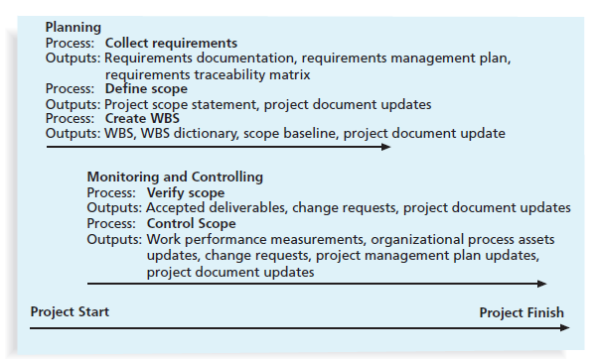

Slide 57
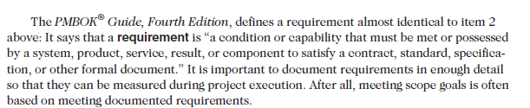

Slide 58
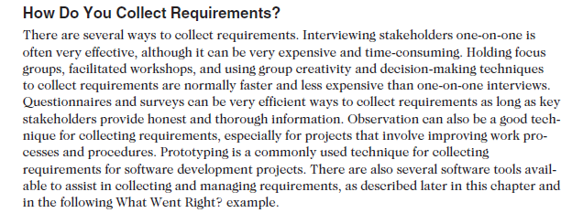

Slide 59
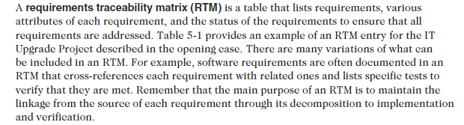

Slide 60
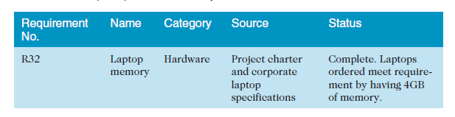

Slide 61


Slide 62


Slide 63


Slide 64
Project Management Infographics
Mercury
Neptune
Mercury is the closest planet to the Sun and the smallest one
Neptune is the farthest planet from the Sun and the fourth-largest one
Earth
Mars
Earth
Despite being red, Mars is a cold place full of iron oxide dust
Earth is the third planet from the Sun and the only one that harbors life

Slide 66
Project Management Infographics
Neptune
Mars
Venus has a nice name and is the second
Neptune is the farthest planet from the Sun and a gas giant
Despite being red, Mars is actually a cold place
Earth is the third planet from the Sun
Jupiter is a gas giant and the biggest planet of them all
Earth
Jupiter

Slide 67
WE can do GOOD QUICK and CHEAP work
GOOD QUICK
Work Wont be CHEAP
You can have any two not Three
GOOD CHEAP
Work Wont be QUICK
QUICK CHEAP
Work Wont be GOOD

Slide 68
Project Management Infographics
Concept 1
Concept 2
Concept 3
Concept 4
Saturn
Jupiter
Venus
Mercury
Saturn is a gas giant made of hydrogen and helium
Jupiter is a gas giant and the biggest planet of them all
Venus has a beautiful name, but also high temperatures
Mercury is the smallest planet in the Solar System

Slide 69
Project Management Infographics
1
2
3
4
Northwest Airlines developed a new reservation system called ResNet
projects are different in size and type. Northwest Airlines developed a new reservation system called ResNet
rary endeavor undertaken to accomplish a unique purpose
Mars
Jupiter
Saturn
Despite being red, Mars is a cold place full of iron oxide dust
Jupiter is the fourth and the biggest planet
Saturn is composed of hydrogen and also helium

Slide 70
Organization Structure
Functional Organizational Structure
Project Organizational Structure
Organization Structure
Matrix Organizational Structure

Slide 71
Meaning of Project
Step 01
Step 02
Step 03
Step 04
PA project is a temporary endeavor undertaken to accomplish a unique purpose
Despite being red, Mars is a cold place
Jupiter is a gas giant and the biggest planet
Neptune is the farthest planet from the Sun

Slide 72
Project management infographics
Saturn
Jupiter
Venus
Mercury
Mars
Saturn is a gas giant made of hydrogen and helium
Jupiter is a gas giant and the biggest planet
Venus is the second planet from the Sun
Mercury is the smallest planet in the Solar System
Despite being red, Mars is actually a cold place

Slide 73
Meaning of Project
A Project is a combination of interrelated activities with well defined objective to complete in specific time period
Projects are different in size and Types
A Project is a Temporary endeavor undertaken to accomplish a unique purpose
The activities are to be performend in Specific Sequence or order and requiere resources such as Money, Meterial, Facility and Space

Slide 74
Examples of IT Projects
Many Organization updrade hardware, softare and network vai project
Organization develop new software or enhance existing system to perform many business functions
Network Configuration, Data Base Management and IT Recovery
IT project involves projects web development, software development, mobile app development.

Slide 75
Project Management Infographics
Mercury
Neptune
Mercury is the closest planet to the Sun and the smallest one
Neptune is the farthest planet from the Sun and the fourth-largest
Mercury
Saturn
Earth
Despite being red, Mars is a cold place full of iron oxide dust
Earth is the third planet from the Sun and the only one that harbors life

Slide 76
Project Management Infographics
Jan
Feb
Mercury
Neptune
Mercury is the closest planet to the Sun and the smallest one
Neptune is the farthest planet from the Sun and the fourth-largest one
Mars
Earth
Despite being red, Mars is a cold place full of iron oxide dust
Earth is the third planet from the Sun and the only one that harbors life
Mar
Apr

Slide 77
Predective Life Cycle
Linear stages of system analysis,design, construction and support
Waterfall Model
Spiral Life Cycle Model
Based on experience with refinements of waterfall model
Progressive development of operational software
Incremental Build Life Cycle Model
Prototyping Life Cycle Model
Developing s/w prototype to clarify user requirements
Heavy involvement of RAD tools CASE,JRP,JAD
RAD life cycle model

Slide 78
Project Management Infographics
01
02
03
04
Mercury is the closest planet to the Sun
Despite being red, Mars is a cold place
Jupiter is a gas giant and the biggest planet
Neptune is the farthest planet from the Sun

Slide 79
Project Management Infographics
Neptune
Mercury
Item 2
Neptune is the farthest planet from the Sun and a gas giant
Mercury is the closest planet to the Sun and the smallest
Item 1
2023
Item 3
Earth
Mars
Earth is the third planet from the Sun
Item 4
Despite being red, Mars is actually a cold place

Slide 80
7 Habits of Highly Effective People
1
Be Proactive.
2
Begin with the End in Mind.
3
Put First Things First
4
Think Win-Win.
5
Synergize.
6
Seek First to Understand, Then to Be Understood
7
Sharpen the Saw
7

Slide 81
Project Management Infographics
Neptune
Neptune is the farthest planet from the Sun and a gas giant
Mars
Despite being red, Mars is a very cold place full of iron oxide dust
Earth
Earth is the third planet from the Sun and the only one that harbors life
Jupiter
Jupiter is a gas giant and the biggest planet in the Solar System

Slide 82
Project Management Infographics
Neptune
Mercury
Neptune is the farthest planet from the Sun and a gas giant
Mercury is the closest planet to the Sun
Earth
Mars
Earth is the third planet from the Sun
Despite being red, Mars is actually a cold place
Jupiter
Jupiter is a gas giant and the biggest planet of them all

Slide 83
Project Management Infographics
Neptune
Neptune is the farthest planet from the Sun
Mars
Despite being red, Mars is a very cold place
Saturn
Saturn is composed of hydrogen and helium
Mercury
Mercury is the closest planet to the Sun

Slide 84
Project management infographics
Saturn
Mercury
Saturn is a gas giant made of hydrogen and helium
Mercury is the smallest planet in the Solar System
Jupiter
Neptune
Jupiter is a gas giant and the biggest planet
Neptune is the farthest planet from the Sun
Venus
Mars
Venus is the second planet from the Sun
Despite being red, Mars is actually a cold place

Slide 85
Planet Jupiter is a gas giant and also the biggest one in the Solar System
Task 1
Project Management Infographics
Mercury is the closest to the Sun and the smallest one in the Solar System
Task 2
Venus has a beautiful name and is the second planet from the Sun. It’s terribly hot—even hotter than Mercury—and its atmosphere is extremely poisonous. It’s the second-brightest natural object in the night sky after the Moon
Despite being red, Mars is a very cold place full of iron oxide dust
Task 3
Earth is the third planet from the Sun and the only one that harbors life

Slide 86
Project Management Infographics
Option 1
Option 2
Option 3
Option 4
Mars
Jupiter
Saturn
Neptune
Despite being red, Mars is actually a cold place
Jupiter is a gas giant and the biggest planet
Saturn is a gas giant and has several rings
Neptune is the farthest planet from the Sun

Slide 87
Project Management Infographics
Day 1
Neptune
Mercury
Neptune is the farthest planet from the Sun and a gas giant
Mercury is the closest planet to the Sun
Day 4
Day 2
Earth
Mars
Day 3
Earth is the third planet from the Sun
Despite being red, Mars is actually a cold place

Slide 88
Project Management Infographics
Mercury
Mercury is the smallest planet in the Solar System
Mars
Despite being red, Mars is actually a cold place
Jupiter
Jupiter is a gas giant and the biggest planet of them all
Neptune
Neptune is the farthest planet from the Sun and a gas giant
Earth
Earth is the third planet from the Sun and the one with life

Slide 89
Project Management Infographics
Despite being red, Mars is actually a cold place
Mercury is the smallest planet in the Solar System
Mars
Mercury
Saturn is composed mostly of hydrogen and helium
2023
Venus is the second planet from the Sun
Saturn
Venus
Planet Jupiter is a gas giant and the biggest one
Neptune is the farthest planet from the Sun
Jupiter
Neptune

Slide 90
Project Management Infographics
Saturn
Mercury
Saturn is composed of hydrogen and helium
Option 1
Mercury is the smallest planet in the Solar System
Option 4
Option 2
Jupiter
Neptune
Jupiter is a gas giant and the biggest planet
Option 3
Neptune is the farthest planet from the Sun

Slide 91
Project Management Infographics
Venus
Neptune
Saturn
Jupiter
Mars
Despite being red, Mars is actually a cold place
Jupiter is a gas giant and also the biggest planet
Saturn is a giant made of hydrogen and helium
Neptune is the farthest planet from the Sun
Venus is the second planet from the Sun

Slide 92
Project Management Infographics
Mercury
Mercury is the smallest planet of them all
Neptune
Neptune is the farthest planet from the Sun
Saturn
Saturn is composed of hydrogen and helium
Jupiter
Jupiter is a gas giant and the biggest planet
Mars
Despite being red, Mars is a very cold place
Venus
Venus is the second planet from the Sun

Slide 93
Project Management Infographics
Planet Saturn is a gas giant composed mostly of hydrogen and helium
01
Saturn
Mercury is the smallest planet in the Solar System and the closest to the Sun
02
Mercury
Despite being red, Mars is a very cold place full of iron oxide dust
03
Mars
Venus has a beautiful name and is the second planet from the Sun
04
Venus

Slide 94
Instructions for use
In order to use this template, you must credit Slidesgo and Freepik in your final presentation and include links to both websites.
You are allowed to:
- Modify this template.
- Use it for both personal and commercial projects.
You are not allowed to:
- Sublicense, sell or rent any of Slidesgo Content (or a modified version of Slidesgo Content).
- Distribute Slidesgo Content unless it has been expressly authorized by Slidesgo.
- Include Slidesgo Content in an online or offline database or file.
- Offer Slidesgo templates (or modified versions of Slidesgo templates) for download.
- Acquire the copyright of Slidesgo Content.
For more information about editing slides, please read our FAQs or visit Slidesgo School:
https://slidesgo.com/faqs and https://slidesgo.com/slidesgo-school

Slide 95
Infographics
You can add and edit some infographics to your presentation to show your data in a visual way.
Choose your favourite infographic and insert it in your presentation using Ctrl C + Ctrl V or Cmd C + Cmd V in Mac.
Select one of the parts and ungroup it by right-clicking and choosing “Ungroup”.
Change the color by clicking on the paint bucket.
Then resize the element by clicking and dragging one of the square-shaped points of its bounding box (the cursor should look like a double-headed arrow). Remember to hold Shift while dragging to keep the proportions.
Group the elements again by selecting them, right-clicking and choosing “Group”.
Repeat the steps above with the other parts and when you’re done editing, copy the end result and paste it into your presentation.
Remember to choose the “Keep source formatting” option so that it keeps the design. For more info, please visit Slidesgo School.

